Slide 1

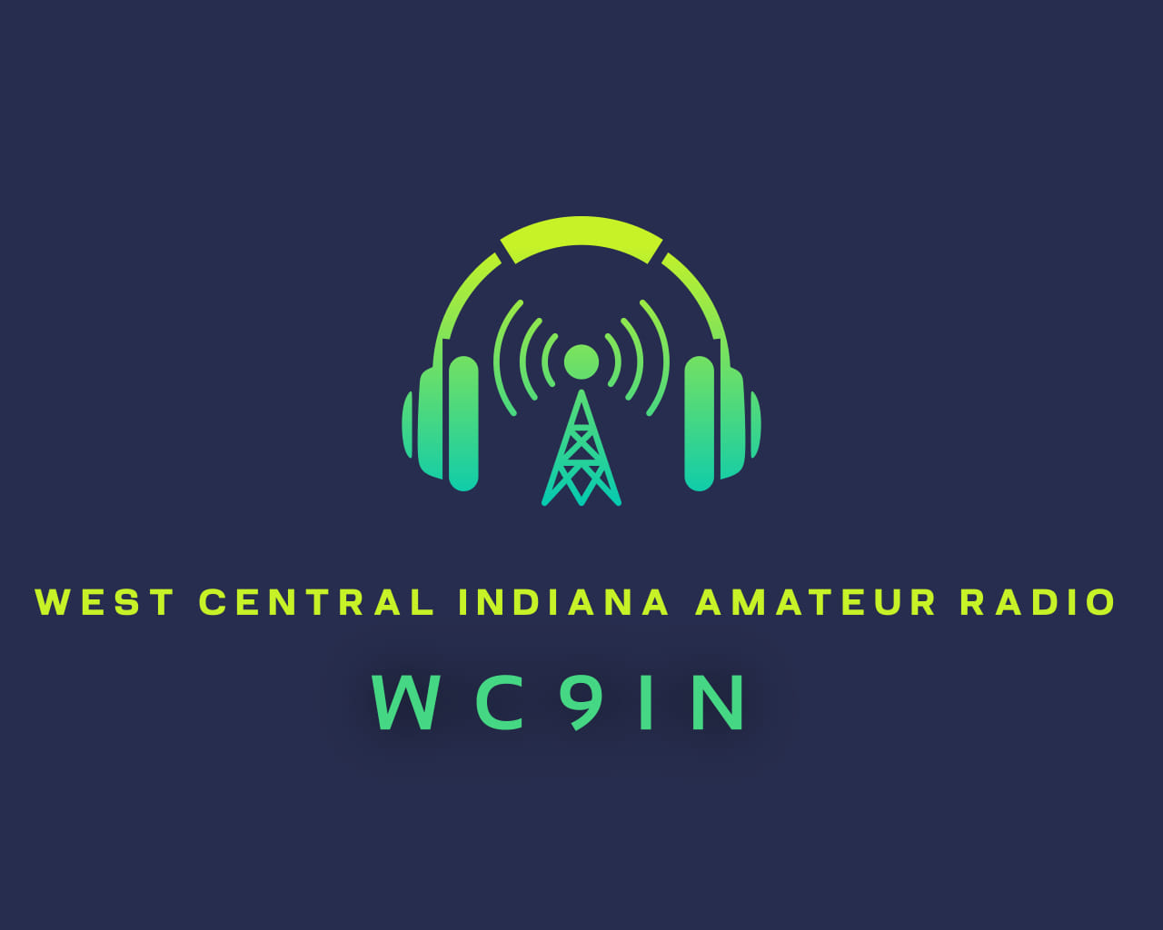

Slide 2
West Central Indiana Amateur Radio is a division of West Lafayette GMRS, a 501(c)3 non-profit organization
Board Members:
Brent Reynolds K9NMT – President/Treasurer
Seth Goodwin K9XG – Trustee & Callsign Trustee
Brandon Hugues W9BDH – Trustee
Cade Rarick KD9RTX – Advisory to the Board
Michelle Davis W9CHL - Secretary
West Central Indiana Amateur Radio (WC-IND) was established with a mission to enhance communication, promote the amateur radio hobby, revitalize underutilized repeaters and to work together with local Amateur Radio groups, clubs, and repeater trustees. Our goal is to provide a broad network of reliable analog FM communications while fostering a vibrant and engaged community of radio enthusiasts.

Slide 3
Formed in November of 2024 as a division of West Lafayette GMRS
Set up a dedicated server on the AllStarlink network for linking analog FM repeaters
Put our first repeater on the air in Northeast Benton County under callsign KE9BYD
Received Vanity Club Call Sign WC9IN on December 10th 2024
Helped Steve Jones W9SMJ put his 442.575 Repeater back on the air in Frankfort, IN and linked it to our network.
Helped put together and install a new UHF repeater in Williamsport for WB9ARC and linked it to our network.
Added a remote receive site in West Lafayette for the W9SMJ Frankfort repeater to help lower power stations get into the system.
Converted the W9SMJ Russiaville 442.525 and Galveston 146.955 Repeaters from RF link to the all-star network. Frankfort 147.045 Repeater will be coming soon.

Slide 4
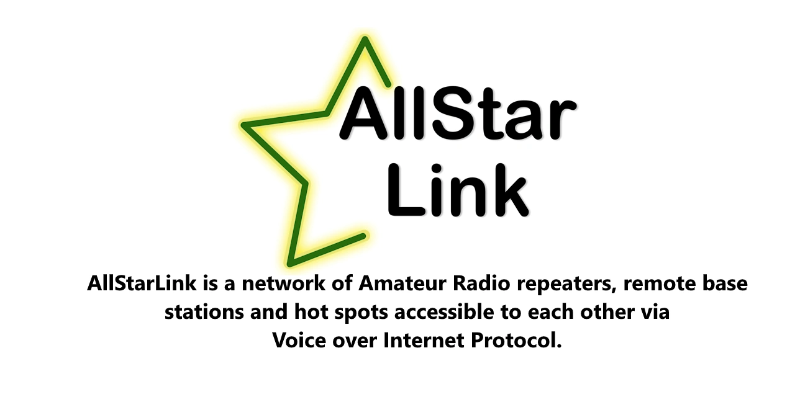
What is the AllStar Link Network?

Slide 5



AllStar Link, Echolink, IRLP…What’s the difference???

Slide 6
AllStar Link
AllStar is a VoIP linking system based on Asterisk, an open-source telephony platform. It uses standard VoIP protocols to connect repeaters, nodes, and individual users.
Hardware: Requires a Raspberry Pi or a Linux-based computer, an interface board, and a radio.
Features:
  Highly customizable and open-source.
  Supports multiple simultaneous connections.
  Better audio quality due to the use of modern codecs
  Provides flexible networking options for building large repeater networks.
Use Cases: Ideal for advanced users or groups that want to build complex, scalable systems with greater control.
Advantages: Open platform, high flexibility, modern features, and support for dynamic node linking.

Slide 7
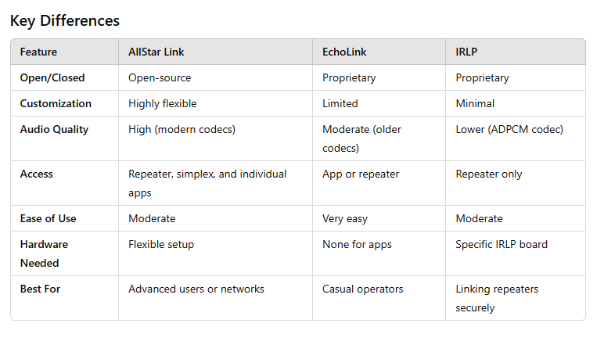

Slide 8
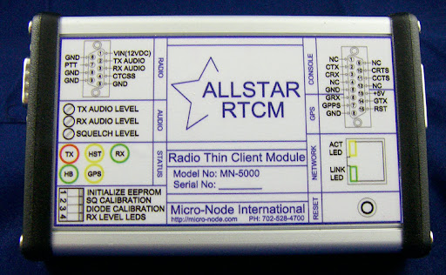
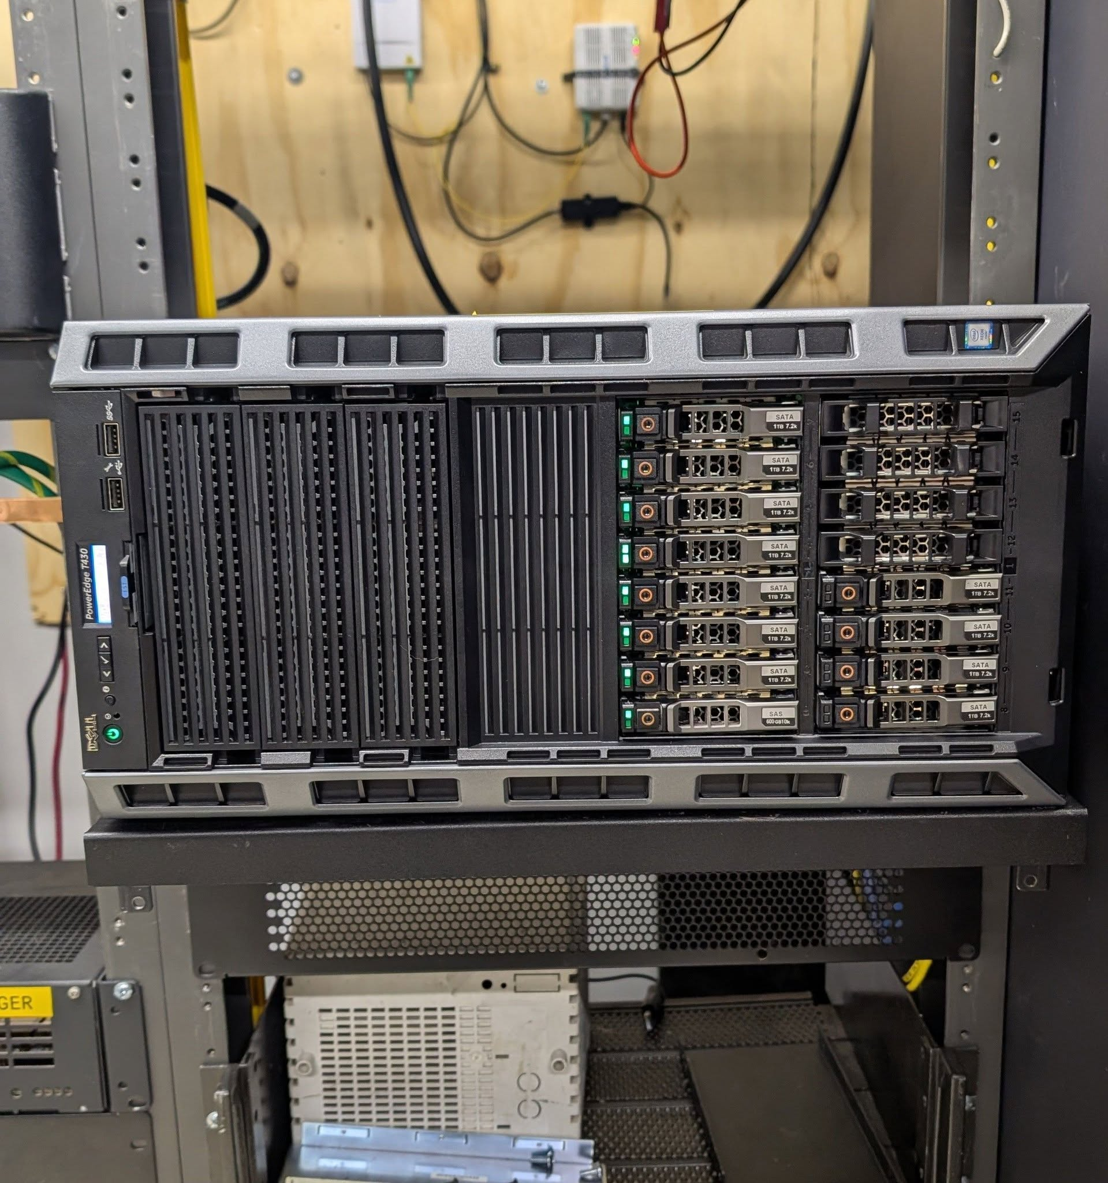
Why did we choose AllStar Link for our host?
We were already used to the platform. myGMRS and GMRS Live! Networks were all built off the same exact software.
Extremely customizable! Being able to build a server from the ground up using Debian 12 to host everything and customize everything to our needs.
All-Star Network was not in the local area as far as repeater systems. There is large repeater network in Southern Indiana (W9ILS) and some scattered repeaters across the state that are All-Star capable.
All-Star Network uses analog FM, the easiest and cheapest way for a newly-licensed operator to get into the hobby.
Ability to host Micro-Node RTCM’s all on one server with ability to add GPS units for receiver voting
Excellent audio quality
Ability to view all connected nodes and see live status of each node
Multiple ways to connect in if out of range of a repeater including: Hotspot, mobile apps like RepeaterPhone for iOS, DV Switch for Android, or desktop software like Transceive for macOS and DV Switch for Windows. These is also ability to use DV Switch to link to digital protocols like DMR, P-25, or D-Star, and even the option to connect a VOIP telephone via services like Hamshack Hotline.
Ability to add on-demand weather alerts from Skywarn Plus or announcements that can be played back to an individual repeater.
Ability to stream ARRL Audio News or Amateur Radio Newsline over a specific repeater
Micro-Node RTCM Radio Interface
Dell Poweredge T430 Server running AllStarlink 3 in West Lafayette

Slide 9
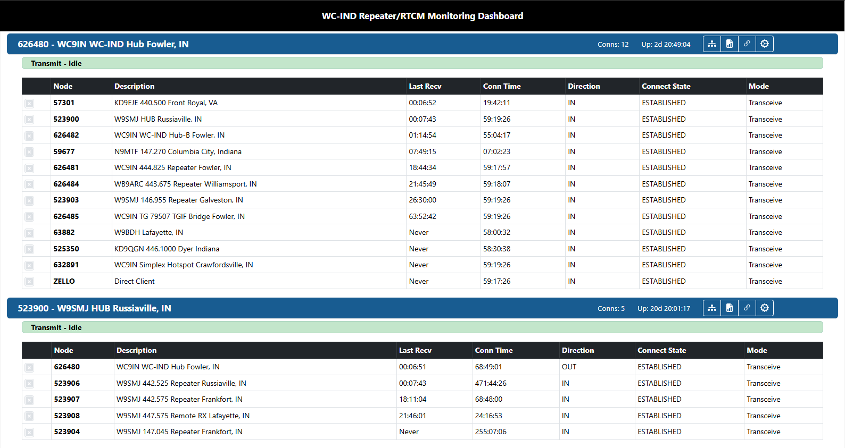
WC-IND Allmon3 Live Status Page – wc9in.duckdns.org/allmon3
All nodes (repeaters/hotspots/links) connected to these “Hubs” would hear the same traffic

Slide 10
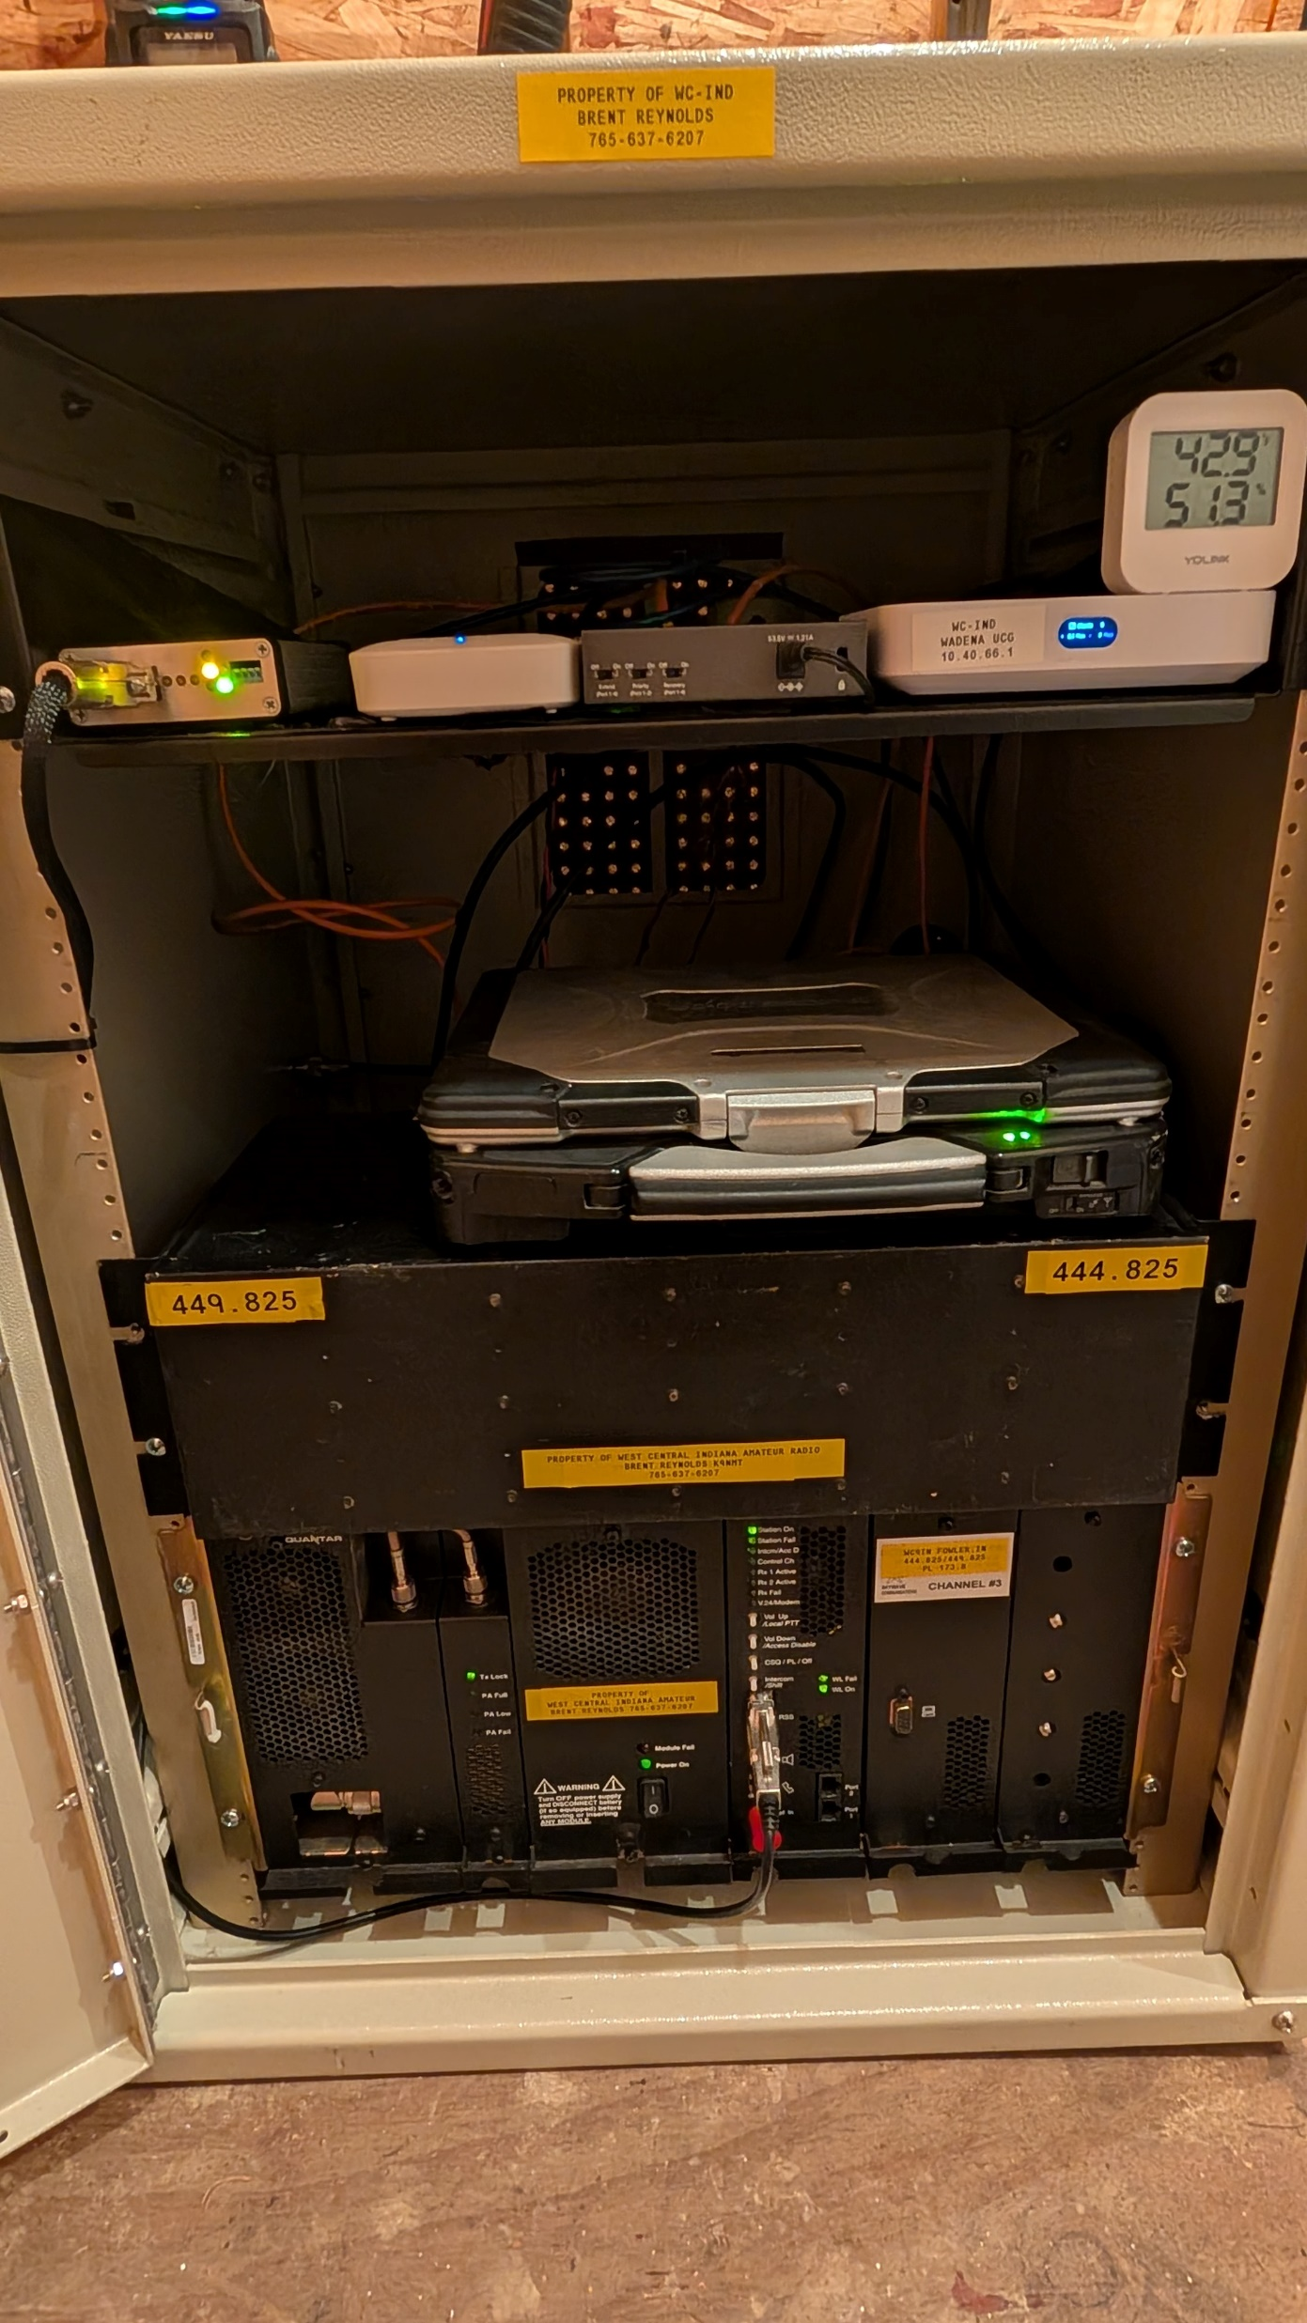
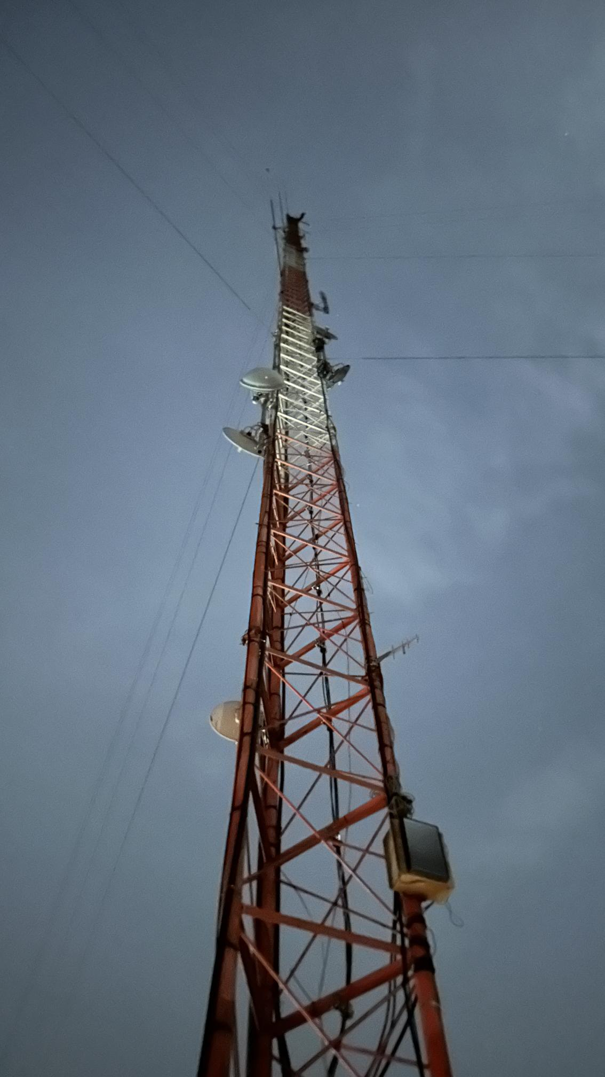
Fowler WC9IN 444.825 Repeater
Motorola Quantar running 110 watts
DB-408 UHF Folded Dipole at 195’
Currently the only HAM repeater in Benton County
Located in Northeast Benton County just north of Wadena
Provides excellent coverage for Benton, Newton, White, Jasper, NW Tippecanoe, and parts of East Central Illinois
Has backup batteries for Repeater and Internet with runtime of almost 3 days.
PL Tone of 173.8

Slide 11
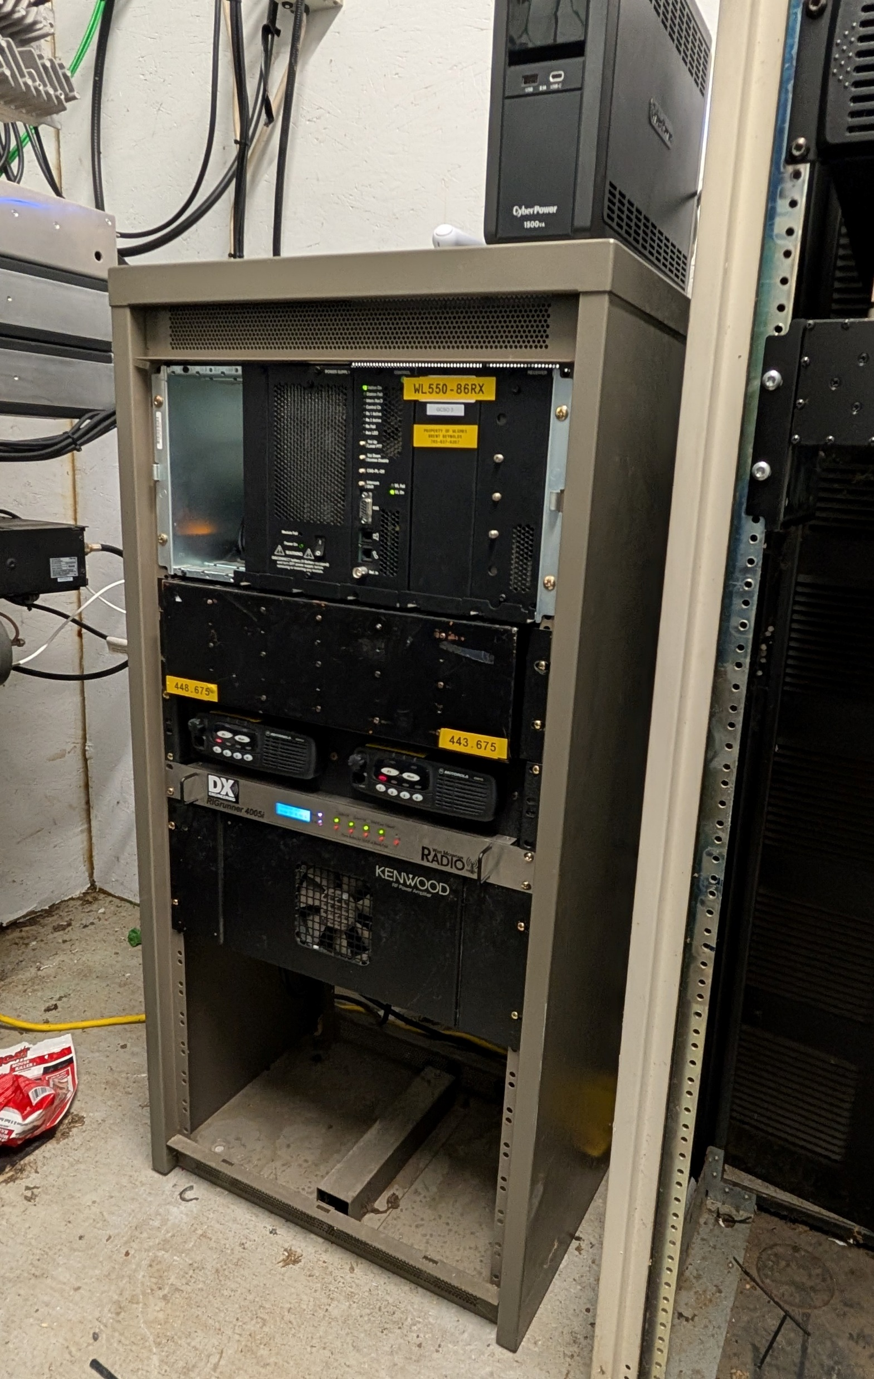
Williamsport WB9ARC 443.675 Repeater
Motorola CDM 750 Radios (running 4 watts) connected to a Kenwood 100-watt amplifier
DB-420 16-Bay UHF Folded Dipole at 225’
Equipment donated to build this repeater by K9NMT, W9SMJ, and the Benton County EMA.
Warren counties only HAM repeater, had very little use before upgrading.
Excellent coverage for Fountain/Warren Counties plus Montgomery, Parke, Danville, IL, and more.
Site has generator backup
PL Tone of 88.5

Slide 12
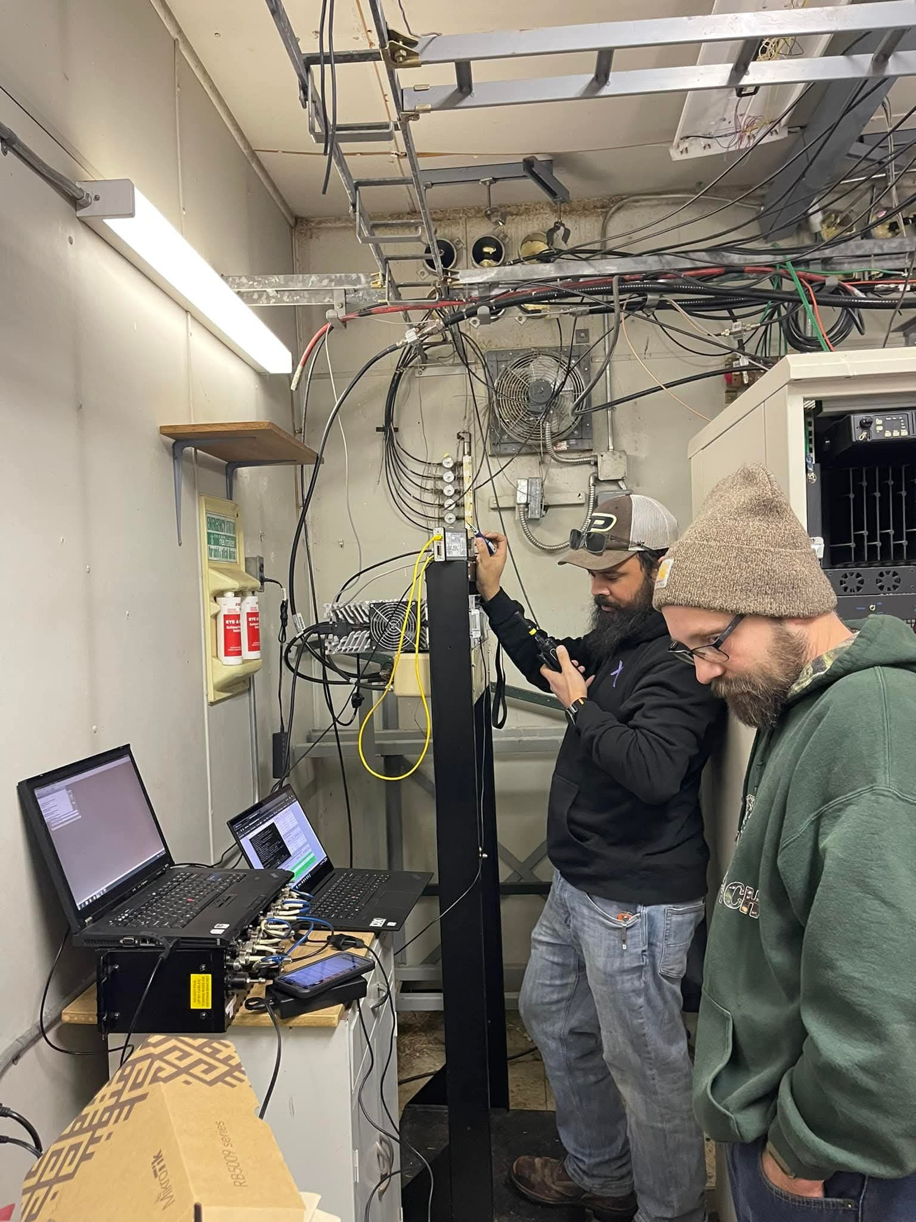
Frankfort W9SMJ 442.575
Motorola MTR2000 UHF 100 Watt Repeater
DB-420 16 Bay UHF Folded Dipole at 300’
Formally the Frankfort 625 GMRS repeater which was decommissioned. The 442.575 has not been on the air since around 2020 and was formerly a YSF repeater.
Located on the Clinton/Boone county line providing excellent coverage for both counties plus Montgomery, Tippecanoe, and more.
Remote Receive site added in West Lafayette to help lower power stations in Tippecanoe county get into the system.
PL for repeater is 173.8, PL for remote receive is 131.8

Slide 13
Repeaters converted over to All-Star Link
W9SMJ Russiaville 442.525 PL 131.8 – Antenna at 200’
W9SMJ Galveston 146.955 PL 131.8 – Antenna at 300’
W9SMJ Frankfort 147.045 PL 173.8 (Coming soon) – Antenna at 300’

Slide 14
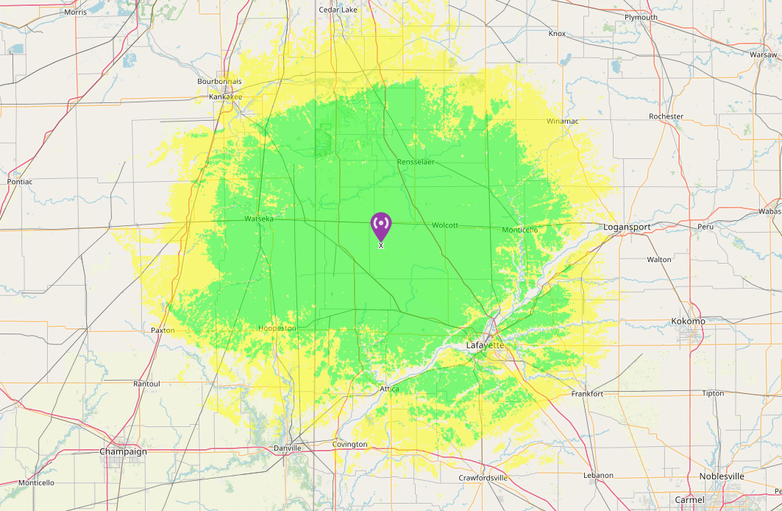
WC9IN 444.825 Repeater Coverage
Site used for creating coverage maps: https://www.ve2dbe.com/rmonline_s.asp

Slide 15
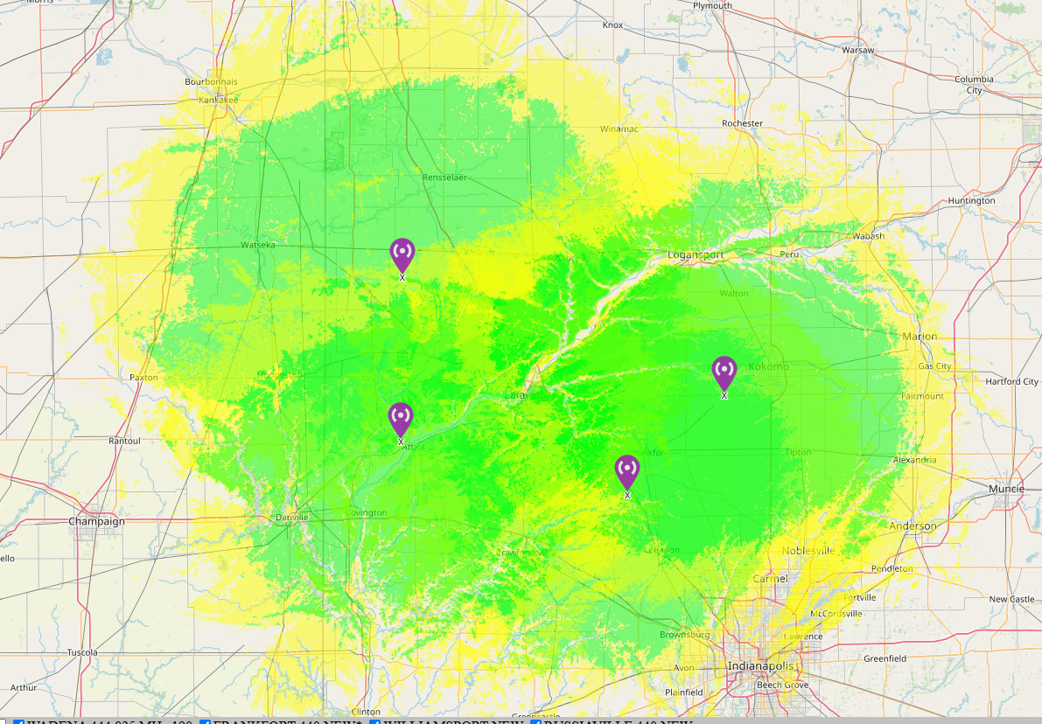
70cm Repeater Coverage Map
I-65 Coverage:
Frankfort – Marion County north line to MM 180
Fowler – MM 176 to Lake County South line
I-74 Coverage:
Williamsport – Danville, IL to IN-32
Frankfort – US-41 to Brownsburg, IN
WC9IN 444.825
W9SMJ 442.525
WB9ARC 443.675
W9SMJ 442.575

Slide 16
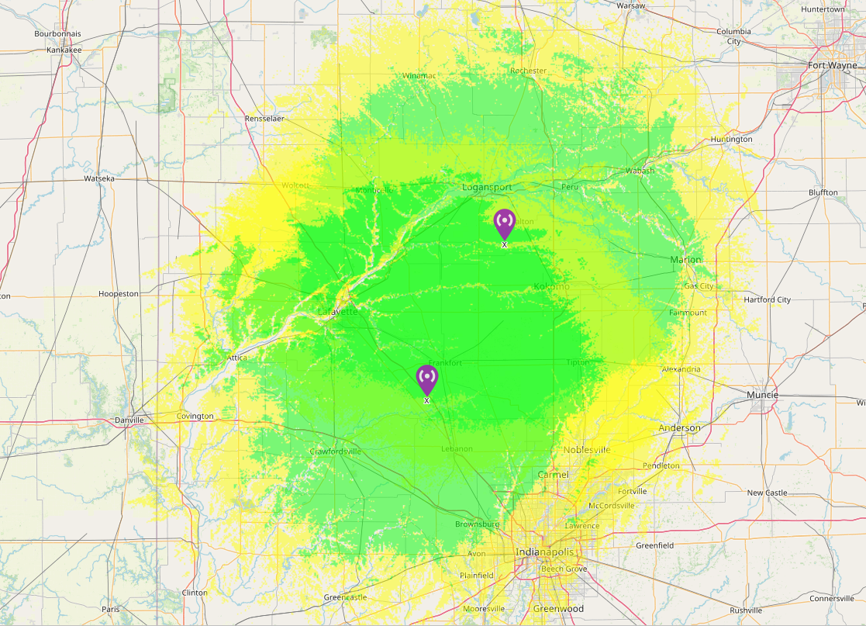
2m Repeater Coverage Map
W9SMJ 146.955
W9SMJ 147.045

Slide 17
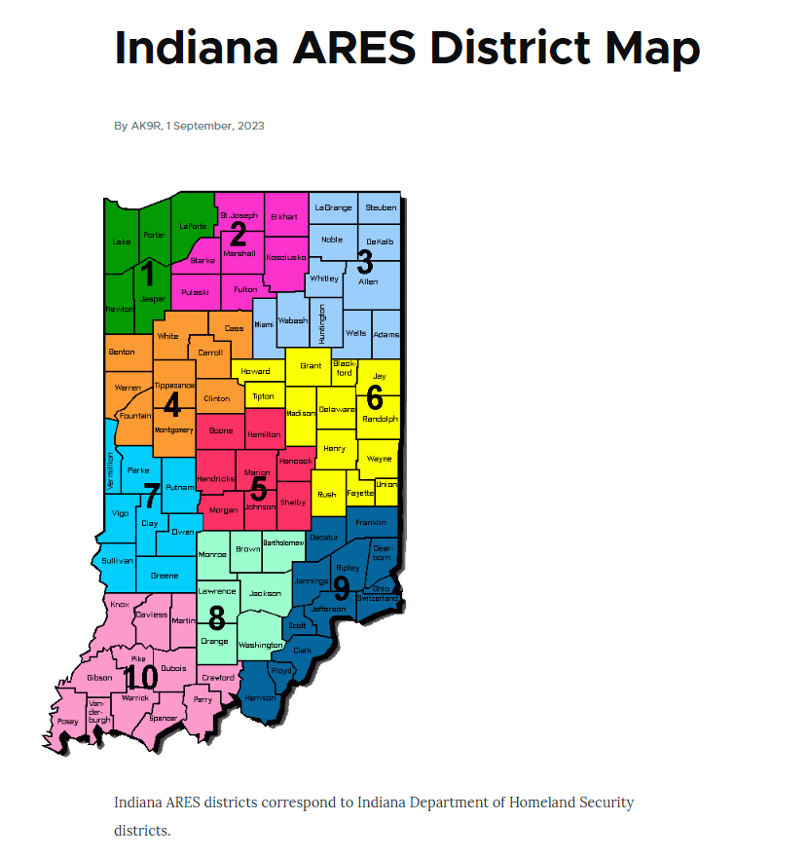
Our linked repeaters cover about 85-90% of Indiana ARES/IDHS District 4 from a mobile.
With a solid base station, there is 100% coverage.
The system is open for any type of ARES related use.

Slide 18
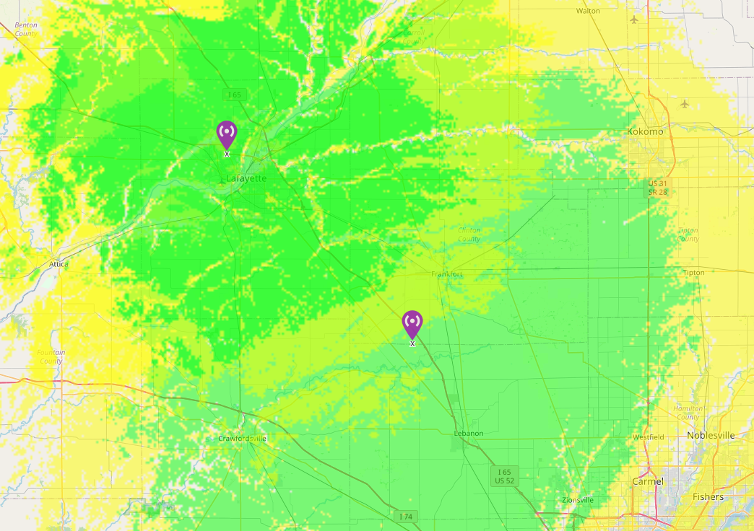
How does a Remote Receive Site Work?
When using a remote receive site, the user transmits into the receive site but will receive their audio back from the actual repeater site. (Notice the arrows the audio path travels)
Users can expect to hear the last word said when they unkey come back to them. Is this due to internet latency.

Slide 19
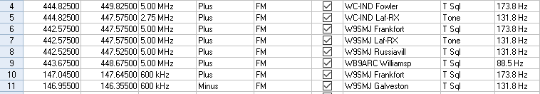
Programming Example: Taken from Yaesu FTM-500/RT Systems
Some Part 97 radios do not allow split CTCSS/PL tones.
For example, the W9SMJ Frankfort repeater has a transmit and receive tone of 173.8 but when using the Remote
Receive in West Lafayette, it has a tone of 131.8 to activate it. In the above example, I had to set up using TONE 131.8
Which leaves the receive side of the radio listening to the repeater on CSQ.
I also made a “Hybrid channel” for the Remote receive site in West Lafayette that would still transmit to the receive site
But then listen to the Fowler repeater instead. This is accomplished by changing the offset to 2.75MHz. This is handy if
The user is still close to the Receive site in West Lafayette but can hear the Fowler repeater better than the Frankfort.

Slide 20
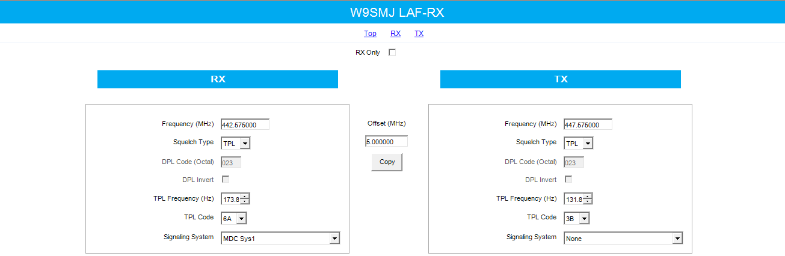
Programming Example: Motorola XPR5550e for the Remote Receive Site
Commercial radios will allow manual frequency entry and squelch type to fit the user’s needs.

Slide 21
Upcoming Plans:
Starting a structured net sometime in March
Looking at streaming ARRL Audio News once a week (Trialed on Feb 10th)
We have the option to connect to other hubs for nets. www.allstarnets.org has a list of open nets that are open for connection.
Improved internet connections for Fowler and Williamsport. Currently both run on cellular modems.
Looking into 5GHz or 60GHz point to point dishes.
Adding Skywarn Plus weather alerts to broadcast specific alerts to certain repeaters
Looking at GPS units later this year for voted receive between Frankfort and the remote receive site
We do not have any plans at the moment to add any additional repeaters. Our focus was mainly for West Central Indiana.

Slide 22


Slide 23
For any additional information, please go to our website at www.wc9in.com
Repeaterbook links, our Facebook page, and the link to our status page can be found there.
Any additional questions, please e-mail me at k9nmt@yahoo.com
Thank you and we hope you enjoy!

